Slide 1
Hibernate XML Mapping

Slide 2
Що потрібно?
JDK
Maven
База даних (наприклад, MySQL)
Hibernate

Slide 3
Створюємо таблицю user
DROP TABLE IF EXISTS `user`;
CREATE TABLE user(
`USER_ID` INT(10) UNSIGNED NOT NULLAUTO_INCREMENT,
`FIRST_NAME` VARCHAR(20) NOT NULL,
`LAST_NAME` VARCHAR(20) NOT NULL,
PRIMARY KEY (`USER_ID`) USING BTREE
) ENGINE=InnoDB DEFAULT CHARSET=utf8;

Slide 4
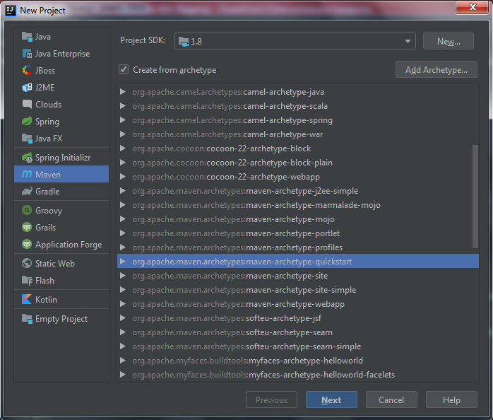
Створюємо maven проект
В Intellij IDEA вибираємо:
File ->
New Project ->
Maven

Slide 5
Додаємо залежності в pom.xml
<?xml version="1.0" encoding="UTF-8"?>
<project xmlns="http://maven.apache.org/POM/4.0.0" xmlns:xsi="http://www.w3.org/2001/XMLSchema-instance" xsi:schemaLocation="http://maven.apache.org/POM/4.0.0 http://maven.apache.org/xsd/maven-4.0.0.xsd"> <modelVersion>4.0.0</modelVersion>
<groupId>com</groupId>
<artifactId>test</artifactId>
<version>1.0-SNAPSHOT</version>
<packaging>jar</packaging>
<properties>
<hibernate.version>4.1.11.Final</hibernate.version> <mysql.version>5.1.24</mysql.version>
</properties>

Slide 6
<dependencies>
…
<dependency>
<groupId>mysql</groupId>
<artifactId>mysql-connector-java</artifactId>
<version>${mysql.version}</version>
</dependency>
<dependency>
<groupId>org.hibernate</groupId>
<artifactId>hibernate-core</artifactId>
<version>${hibernate.version}</version>
</dependency>
…
</dependencies>

Slide 7
Створюємо Mapping «User.hbm.xml»
<?xml version="1.0"?>
<!DOCTYPE hibernate-mapping PUBLIC "-//Hibernate/Hibernate Mapping DTD 3.0//EN"
"http://hibernate.sourceforge.net/hibernate-mapping-3.0.dtd">
<hibernate-mapping>
<class name="com.entity.User" table="user" catalog="test">
<id name="userId" type="java.lang.Integer">
<column name="USER_ID" />
<generator class="identity" />
</id>
<property name="firstName" type="string">
<column name="FIRST_NAME" length="20" not-null="true" unique="true" /> </property>
<property name="lastName" type="string">
<column name="LAST_NAME" length="20" not-null="true" unique="true" />
</property>
</class>
</hibernate-mapping>
catalog="test" – це назва БД. table="user" – це назва таблиці, до якої ми прив’язуємо клас User.java.
Для цього створюємо пакет entity і в ньому створюємо сутність User.java

Slide 8
Hibernate entity relations
Всередині xml файлу також можна описувати зв’язки між ентітями.
Наприклад:
<one-to-many class="com.Classname" />
<many-to-one class="com.Classname“ name="stock" >
<many-to-many entity-name="com.Classname">
<column name=“TEST_ID" not-null="true" />
</many-to-many>

Slide 9
public class User {
private Integer userId;
private String firstName;
private String lastName;
public User(String firstName, String lastName) {
this.firstName = firstName;
this.lastName = lastName;
}
public User() {
}
public String getLastName() { return lastName; }
public void setLastName(String lastName) { this.lastName = lastName; }
public String getFirstName() { return firstName; }
public void setFirstName(String firstName) { this.firstName = firstName; }
public Integer getUserId() { return userId; }
public void setUserId(Integer userId) { this.userId = userId; }
}

Slide 10
Створюємо hibernate.cfg.xml файл
<?xml version="1.0" <?xml version="1.0" encoding="utf-8"?>
<!DOCTYPE hibernate-configuration PUBLIC
"-//Hibernate/Hibernate Configuration DTD 3.0//EN"
"http://hibernate.sourceforge.net/hibernate-configuration-3.0.dtd">
<hibernate-configuration>
<session-factory>
<property name="hibernate.connection.driver_class">com.mysql.jdbc.Driver</property>
<property name="hibernate.connection.password">root</property>
<property name="hibernate.connection.url">jdbc:mysql://localhost:3306/test</property>
<property name="hibernate.connection.username">root</property>
<property name="hibernate.dialect">org.hibernate.dialect.MySQLDialect</property>
<property name="show_sql">true</property>
<mapping resource="com/User.hbm.xml"></mapping>
</session-factory>
</hibernate-configuration>="utf-8"?>

Slide 11
Створюємо Hibernate Utility клас
public class HibernateUtil {
private static final SessionFactory sessionFactory = buildSessionFactory();
private static ServiceRegistry serviceRegistry;
private static SessionFactory buildSessionFactory() {
try {
Configuration configuration = new Configuration();
configuration.configure();
serviceRegistry = new ServiceRegistryBuilder().applySettings(configuration.getProperties())
.buildServiceRegistry();
return configuration.buildSessionFactory(serviceRegistry);
}
catch (Throwable ex) {
System.err.println("Initial SessionFactory creation failed." + ex);
throw new ExceptionInInitializerError(ex);
}
}
public static SessionFactory getSessionFactory() { return sessionFactory; }
public static void shutdown() {
getSessionFactory().close();
}
}

Slide 12
Зберігання user в БД
public class EnterPoint {
public static void main(String[] args) {
Session session = HibernateUtil.getSessionFactory().openSession();
session.beginTransaction();
User user = new User();
user.setFirstName(“John");
user.setLastName(“Doe");
session.save(user);
session.getTransaction().commit();
}
}

